Slide 1
Superhero Website By: Ramadan Abdelrahman

Slide 2
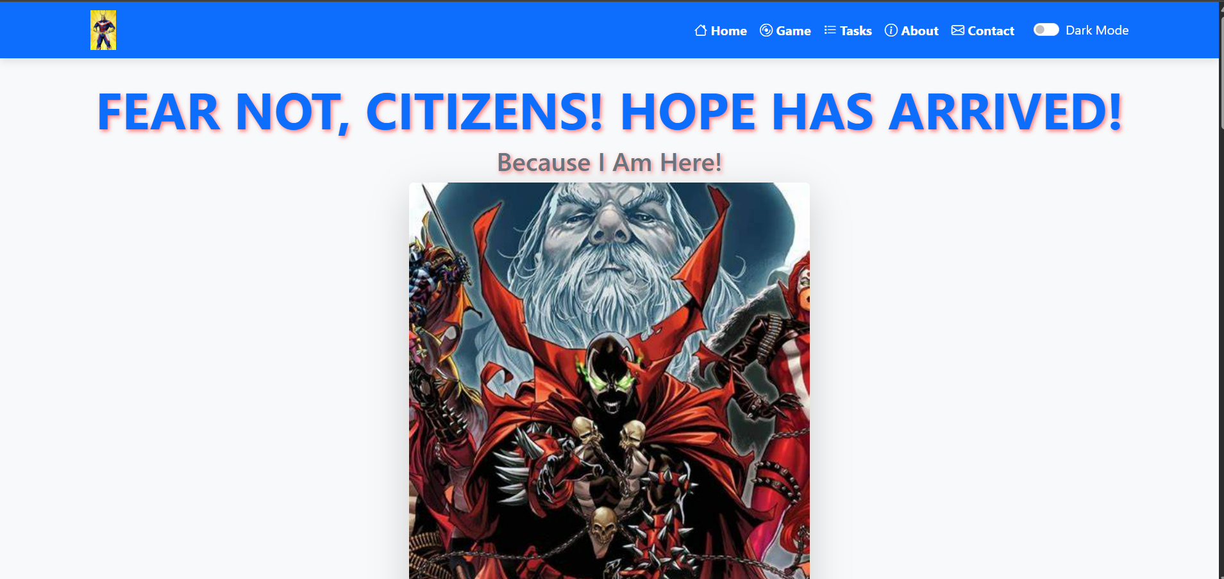
Home
Navigation Bar: A responsive Bootstrap-based navbar that facilitates easy navigation across the platform.
Dark Mode Toggle: A JavaScript-powered dark mode switch for user preference customization.
Interactive Gaming Elements: Features quizzes, character-matching games, and mission tracking.

Slide 3
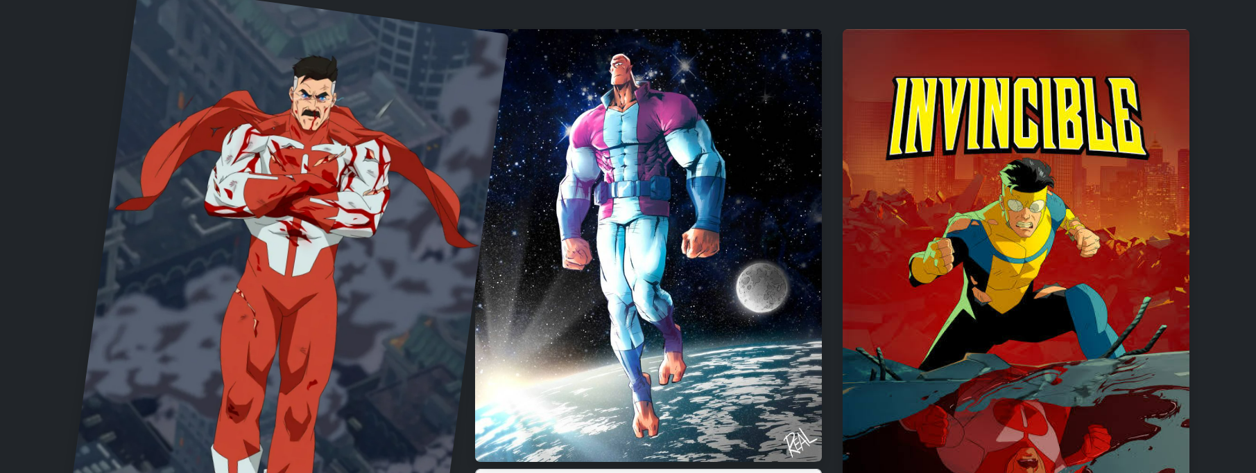
Game

Slide 4
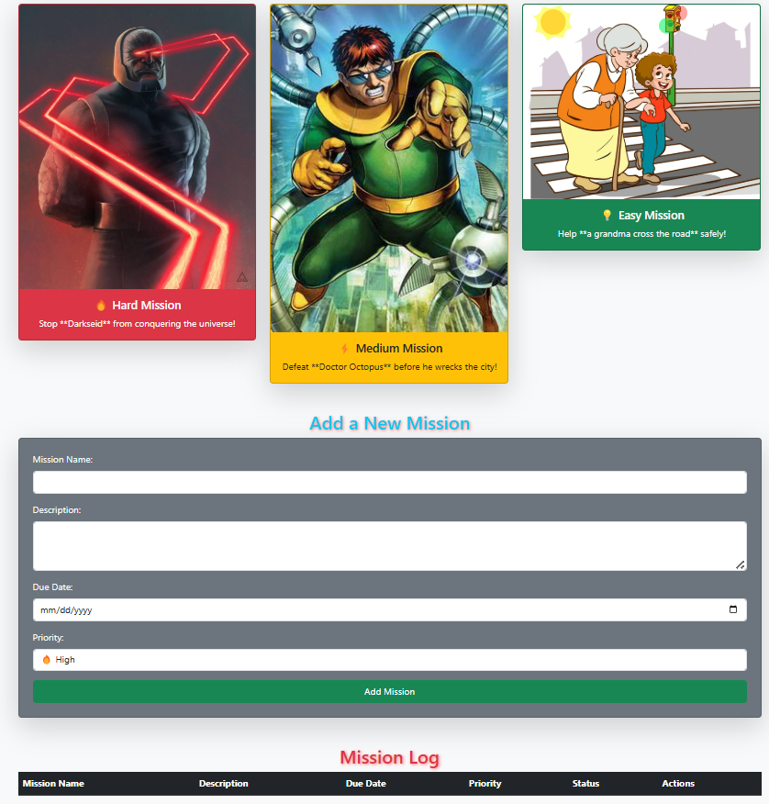
Tasks
Selection
Log
Input
Validation

Slide 5
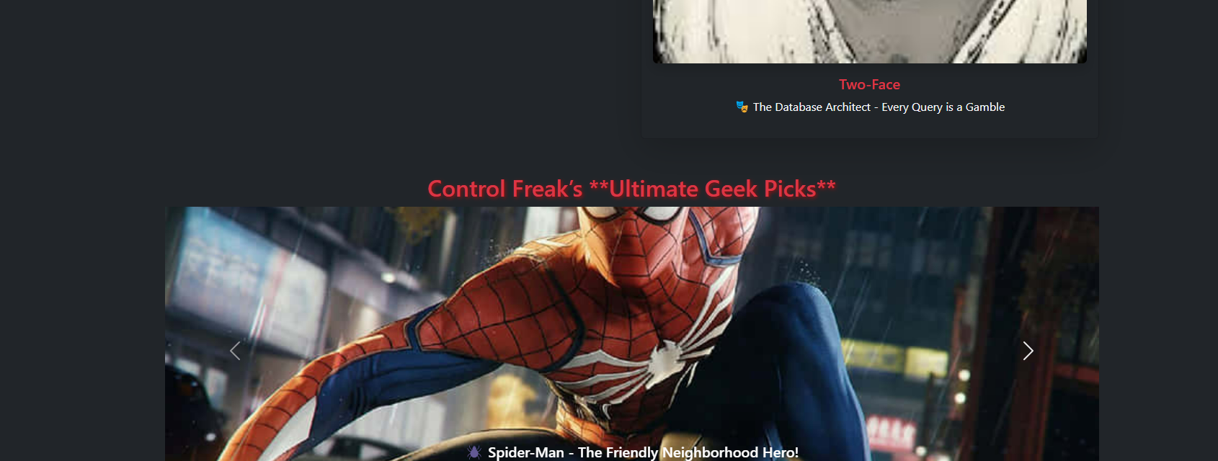
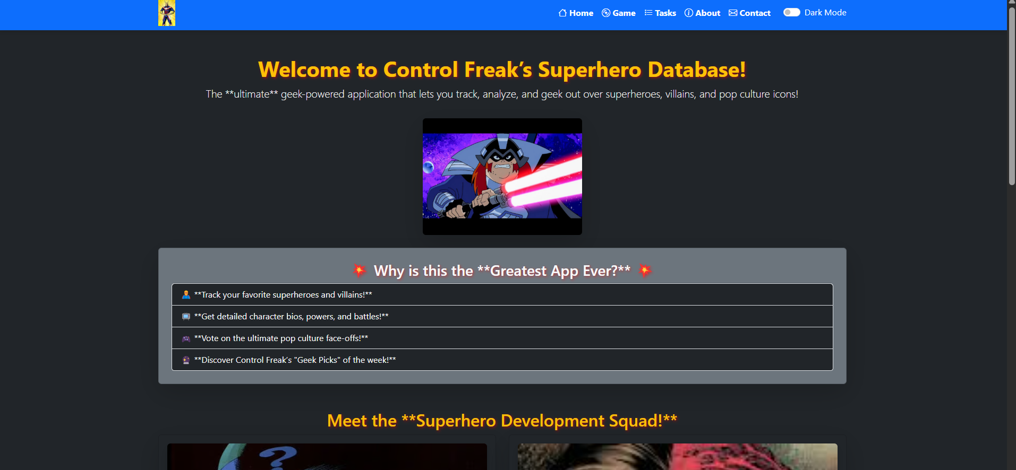
About
Carousel
Team

Slide 6
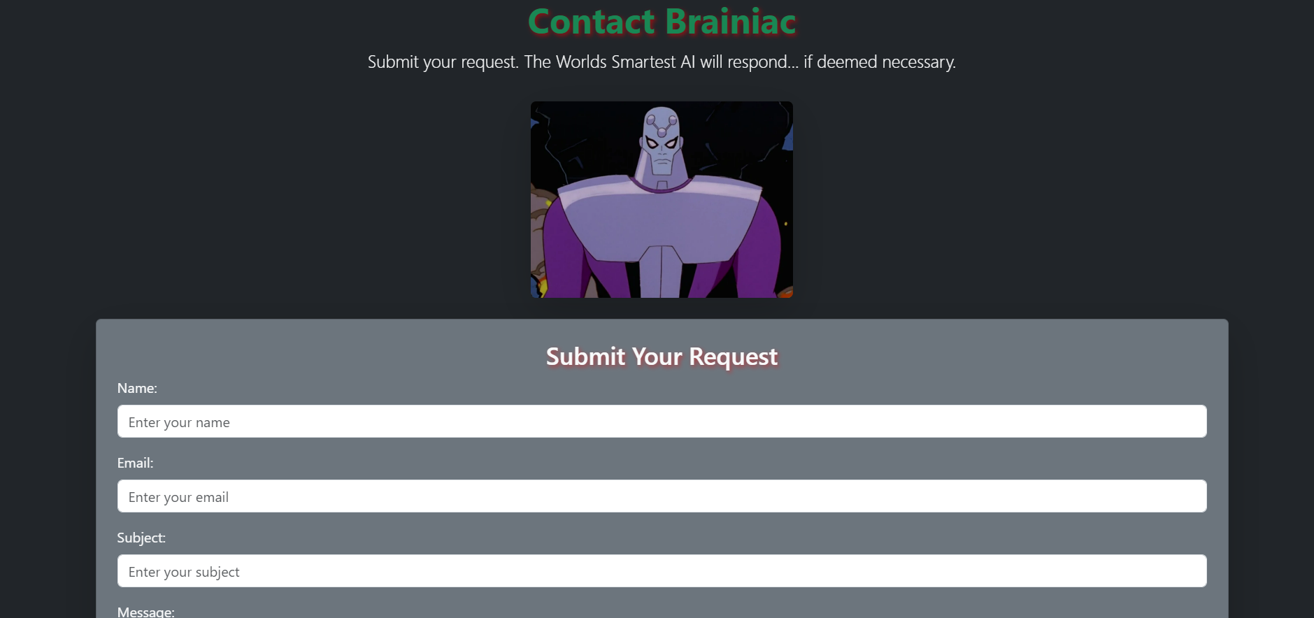
Contact
User Input
Validation Email
Alerts when correct prompts are input or not
Metric | Measurement | Target | Actual
Audience attendance | # of attendees | 150 | 120
Engagement duration | Minutes | 60 | 75
Q&A interaction | # of questions | 10 | 15
Positive feedback | Percentage (%) | 90 | 95
Rate of information retention | Percentage (%) | 80 | 85

Slide 7
Thank you
Ramadan Abdelrahman

